Slide 1
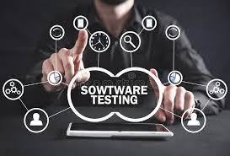

Slide 2
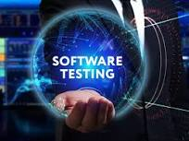

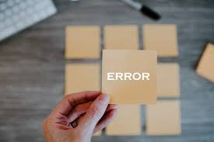
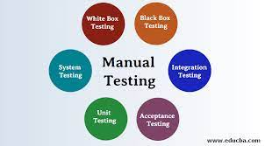
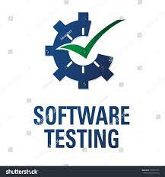

CONTENTS
Introduction of software testing
Finishing of software testing
Definition of software testing
Need for software testing
Error – failure – defects
Causes of software defects
What is software testing reveal ?
Importance software testing
Importance of early testing in SDLC
Testing and quality perception
7 testing principals
Economics of testing

Slide 3
INTRODUCTION OF SOFTWARE TESTING

Slide 4
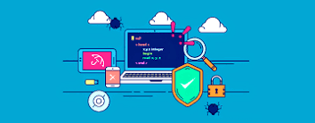
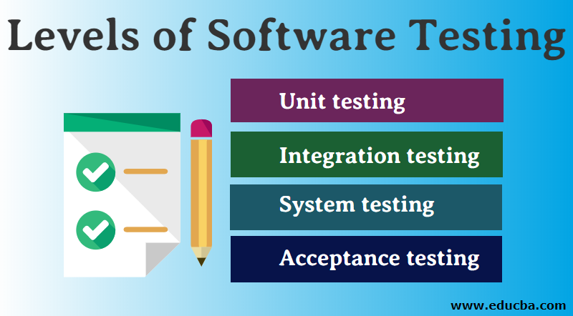
INTRODUCTION OF SOFTWARE TESTING
Testing is important because software bugs could be expensive or even dangerous.
The important reasons for using software testing are:
cost-effective
Security
Product quality
Customer satisfaction
The important strategies in software engineering are:
Unit testing
Integration testing
Validation testing
System testing
Software testing is widely used technology because it is compulsory to test each and every software before deployment.

Slide 5
FINISHING OF SOFTWARE TESTING

Slide 6
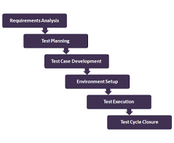
FINISHING OF SOFTWARE TESTING
Requirements analysis is the process of determining user expectations for a new or modified product.
A test planning is a effort of setting out how the software will be checked, what specifically will be tested, and who will be performing the test.
A test case is a document, which includes test data, preconditions, expected results and post conditions, developed for a particular test scenario in order to verify compliance against a specific requirement.
It is a combination of hardware and software environment on which the tests will be executed.
Test execution is the process of executing the code and comparing the expected and actual results.
Test Closure is a document that gives a summary of all the tests conducted during the software development life cycle, it also gives a detailed analysis of the bugs removed and errors found .
This is finishing of software testing.

Slide 7
DEFINITION OF SOFTWARE TESTING

Slide 8
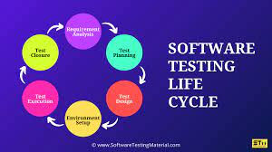
DEFINITION OF SOFTWARE TESTING
Software testing is a process of identifying the correctness of software by considering its all attributes and evaluating the execution of software components to find the software bugs or errors or defects.
Software testing is widely used technology because it is compulsory to test each and every software before deployment.
Software testing provides an independent view and objective of the software and gives surety of fitness of the software.
It involves testing of all components under the required services to confirm that whether it is satisfying the specified requirements or not.
The process is also providing the client with information about the quality of the software.

Slide 9

TESTING
Testing is mandatory because it will be a dangerous situation if the software fails any of time due to lack of testing. So, without testing software cannot be deployed to the end user.
Testing is a group of techniques to determine the correctness of the application under the predefined script but, testing cannot find all the defect of application.
Checking product and documentation in order to determine how far the needs or requirements are met, to find defects, to measure quality and risk, to establish confidence and to prevent defects.
Testing includes an examination of code and also the execution of code in various environments, conditions as well as all the examining aspects of the code.
In the current scenario of software development, a testing team may be separate from the development team so that Information derived from testing can be used to correct the process of software development.

Slide 10
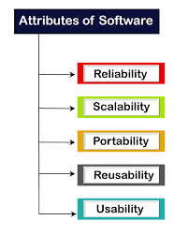
RELIADILITY:
Reliability is an important software testing technique that is performed by the team to ensure that the software is performing and functioning consistently in each environmental condition as well as in a specified period.
SCALABILITY:
A scalability test is a type of load testing that measures the application's ability to scale up or down as a reaction to an increase in the number of users.
PORTABILITY:
Portability testing is a process of testing with ease with which the software or product can be moved from one environment to another.
REUSABILITY:
Reusability is the use of existing assets in some form within the software product development process; these assets are products and by-products of the software development life cycle and include code, software components, test suites, designs and documentation.
USABILITY:
Usability testing refers to evaluating a product or service by testing it with representative users.

Slide 11
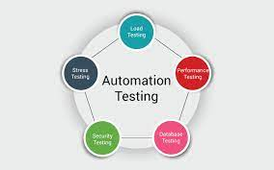
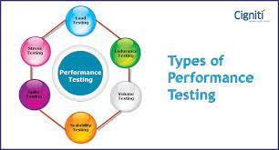
TYPES OF TESTING
Manual testing:
The process of checking the functionality of an application as per the customer needs without taking any help of automation tools is known as manual testing.
Automation testing:
Automation testing is a process of converting any manual test cases into the test scripts with the help of automation tools, or any programming language is known as automation testing.
Performance testing:
Performance testing is a testing measure that evaluates the speed, responsiveness and stability of a computer, network, software program or device under a workload.

Slide 12
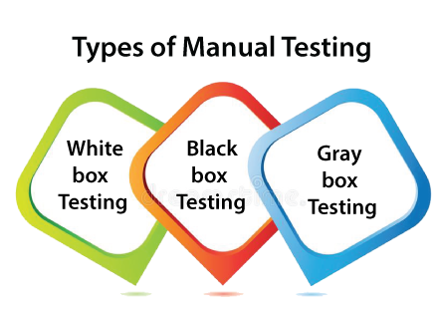
MANUAL TESTING
White-box testing:
The white box testing is done by Developer, where they check every line of a code before giving it to the Test Engineer. Since the code is visible for the Developer during the testing, that's why it is also known as White box testing.
Black box testing:
The black box testing is done by the Test Engineer, where they can check the functionality of an application or the software according to the customer /client's needs. In this, the code is not visible while performing the testing; that's why it is known as black-box testing.
Gray Box testing:
Gray box testing is a combination of white box and Black box testing. It can be performed by a person who knew both coding and testing. And if the single person performs white box, as well as black-box testing for the application, is known as Gray box testing.

Slide 13
NEEDS OF SOFTWARE TESTING

Slide 14
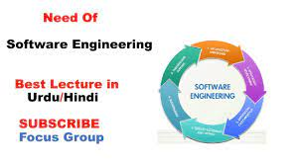
NEEDS OF SOFTWARE TESTING
The goal of software testing is to find errors, gaps, or missing requirements in comparison to the actual requirements.
When a software development project is going on, you need to know that errors may appear in any phase of the life cycle.
Few of them are known to be undiscovered.
A tester must be able to communicate clearly, accurately and demonstrate a high capacity of comprehension.
Communication skill here includes activities such as reading and understanding specifications, translating those into structured test cases, reporting bugs and writing clear and concise reports to management.

Slide 15
ERROR – FAILURE - DEFECTS

Slide 16
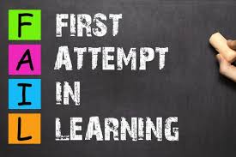

ERROR – FAILURE - DEFECTS
ERROR :
Error handling testing is a type of software testing which is performed to test the ability of the system to handle the errors and exceptions in the software during runtime. This testing is performed with the help of both developers and testers.
FAILURE:
A failure is the inability of a software system or component to perform its required functions within specified performance requirements. When a defect reaches the end customer it is called a Failure. During development, Failures are usually observed by testers.
DEFECTS:
A Defect in Software Testing is a variation or deviation of the software application from end user's requirements or original business requirements. A software defect is an error in coding which causes incorrect or unexpected results from a software program which does not meet actual requirements.

Slide 17
CAUSES OF SOFTWARE DEFECTS

Slide 18
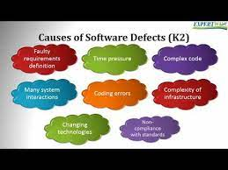
CAUSES OF SOFTWARE DEFECTS
The possibility of Defects introduced can just happen because of the following reasons:
Miscommunication or no communication,
Software complexity,
Programming errors,
Changing requirements,
Time pressures,
Poorly documented code,
Software development tools,
Obsolete automation scripts.

Slide 19
WHAT IS SOFTWARE TESTING REVEAL?

Slide 20
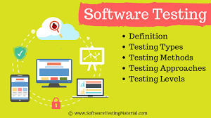
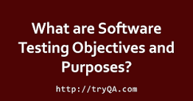
WHAT IS SOFTWARE TESTING REVEAL?
Software testing is the process of evaluating and verifying that a software product or application does what it is supposed to do.
The benefits of testing include preventing bugs, reducing development costs and improving performance.
Test management plan.
The major objectives of Software testing are as follows:
Finding defects which may get created by the programmer while developing the software.
Gaining confidence in and providing information about the level of quality.
To prevent defects.

Slide 21
IMPORTANCE OF SOFTWARE TESTING

Slide 22
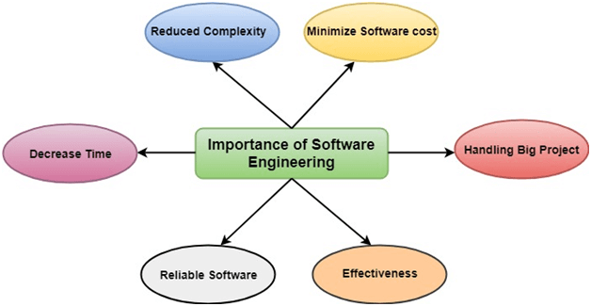
IMPORTANCE OF SOFTWARE TESTING
There are few importance of software testing. They are:
Reduces complexity
To minimize software cost
To decrease time
Handling big projects
Reliable software
Effectiveness

Slide 23
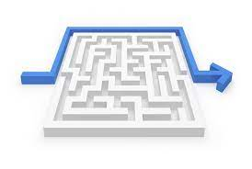
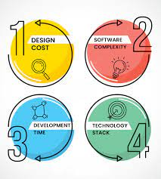
Reduces complexity:
Big software is always complicated and challenging to progress. Software engineering has a great solution to reduce the complication of any project
To minimize software cost:
Software needs a lot of hard work and software engineers are highly paid experts. A lot of manpower is required to develop software with a large number of codes.

Slide 24
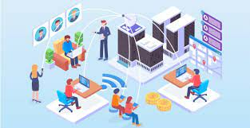

To decrease time:
Anything that is not made according to the project always wastes time. And if you are making great software, then you may need to run many codes to get the definitive running code.
Handling big projects:
Big projects are not done in a couple of days, and they need lots of patience, planning, and management. And to invest six and seven months of any company, it requires heaps of planning, direction, testing, and maintenance.

Slide 25


Reliable software:
Software should be secure, means if you have delivered the software, then it should work for at least its given time or subscription. And if any bugs come in the software, the company is responsible for solving all these bugs.
Effectiveness:
Effectiveness comes if anything has made according to the standards. Software standards are the big target of companies to make it more effective.

Slide 26
Importance of early testing in SDLC

Slide 27
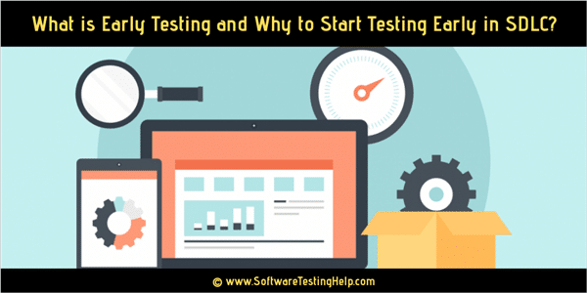
Importance of early testing in SDLC
Software testing should start early in the Software Development Life Cycle.
This helps to capture and eliminate defects in the early stages of SDLC i.e requirement gathering and design phases.
An early start to testing helps to reduce the number of defects and ultimately the rework cost in the end.
This is early testing in SDLC.

Slide 28
Testing and quality perception

Slide 29
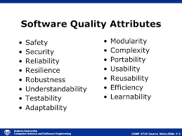
Testing and quality perception
Perceived Quality is the impression of excellence that a customer experiences about a product, brand or business, derived through sight, sound, touch, and scent.

Slide 30
7 testing principals

Slide 31
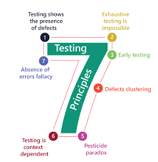
7 testing principals
The seven principles of testing:
Testing shows the presence of defects, not their absence.
Exhaustive testing is impossible.
Early testing saves time and money.
Defects cluster together.
Beware of the pesticide paradox.
Testing is context dependent.
Absence-of-errors is a fallacy.

Slide 32
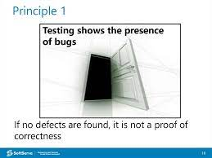
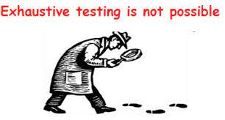
7 testing principals
Testing shows the presence of defects, not their absence
We test software to discover issues, so that they can be fixed before they are deployed to live environments – this enables us to have confidence that our systems are working.
Exhaustive testing is impossible
As much as we would like to believe or wish it true(!), it is absolutely impossible to test EVERYTHING – all combinations of inputs and preconditions – and you could also argue that attempting to do so is not an efficient use of time and budget.

Slide 33
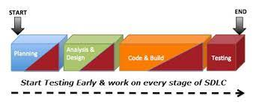
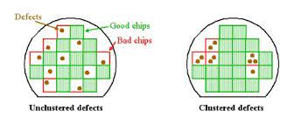
Early testing saves time and money
Testing early is fundamentally important in the software lifecycle. This could even mean testing requirements before coding has started, for example – amending issues at this stage is a lot easier and cheaper than doing so right at the end of the product’s lifecycle, by which time whole areas of functionality might need to be re-written, leading to overruns and missed deadlines.
Defects cluster together
This is the idea that certain components or modules of software usually contain the most number of issues, or are responsible for most operational failures. Testing therefore, should be focused on these areas (proportionally to the expected – and later observed – defect density of these areas)

Slide 34
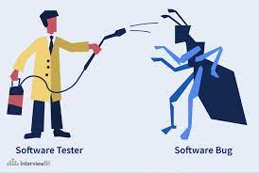
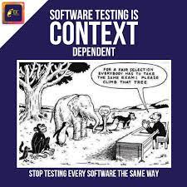
Beware of the pesticide paradox
This is based on the theory that when you use pesticide repeatedly on crops, insects will eventually build up an immunity, rendering it ineffective. Similarly with testing, if the same tests are run continuously then – while they might confirm the software is working – eventually they will fail to find new issues.
Testing is context dependent
Testing is ALL about the context. The methods and types of testing carried out can completely depend on the context of the software or systems – for example, an e-commerce website can require different types of testing and approaches to an API application, or a database reporting application.

Slide 35
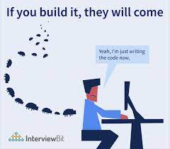
Absence-of-errors is a fallacy
If your software or system is unusable (or does not fulfill users’ wishes) then it does not matter how many defects are found and fixed – it is still unusable. So in this sense, it is irrelevant how issue- or error-free your system is; if the usability is so poor users are unable to navigate, or/and it does not match business requirements then it has failed, despite having few bugs.

Slide 36
Economics of testing

Slide 37
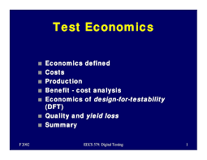
Economics of testing
There is a definite economic impact of software testing. One economic impact is from the cost of defects.
This is a very real and very tangible cost. Another economic impact is from the way we perform testing.
It is possible to have very good motivations and testing goals while testing in a very inefficient way.
Some problems in getting accurate, clear, and testable requirements are:
• Many people do not have a solid requirements gathering process
• Few people have been trained in or understand the dynamics of requirements
• Projects, people, and the world around us change very quickly
• The English language is ambiguous and even what we consider clear language can be interpreted differently by different people.

Slide 38


